Slide 1
SOURCING
DEVELOPMENT
$1330 per style
subject to complexity
SOURCING INTAKE SESSION
DEVELOPMENT ONBOARDING SESSION
EXPERT INPUT AND PLANNING
TEG SPECIFICATION SHEETS COMPLETED
SWATCHES AND TRIMS GATHERED
TECHNICAL INTAKE WITH PATTERN MAKER
NEGOTIATE PRICING AND MINIMUMS
FIRST PATTERNS & FIRST SAMPLES
GUIDANCE IN POs AND ORDERING
ONE FITTING WITH PATTERN MAKER
TRACKING RECEIPT OF ORDERS
ONE ROUND OF FIT ADJUSTMENTS
1-2 ROUNDS OF REVISIONS
ONE DUPLICATE PER STYLE
FINAL PRODUCTION READY PATTERNS

Slide 2
SOURCING
DESIGN
DEVELOPMENT
$1330 per style
$1330 per service
$2790 per style
can be shared up to 5 styles, subject to complexity
subject to complexity
SOURCING INTAKE SESSION
TREATMENT INTAKE SESSION
DEVELOPMENT ONBOARDING SESSION
EXPERT INPUT AND PLANNING
EXPERT INPUT AND PLANNING
TECHNICAL INTAKE SESSION WITH PATTERNMAKER
SWATCHES AND TRIMS GATHERED
ARTWORK / COLOR APPROVAL
TEG SPECIFICATION SHEETS COMPLETED
NEGOTIATE PRICING AND MINIMUMS
NEGOTIATE PRICING AND MINIMUMS
FIRST PATTERNS & FIRST SAMPLES
GUIDANCE IN POs AND ORDERING
GUIDANCE IN POs AND
ORDERING
ONE FITTING WITH PATTERN MAKER
TRACKING RECEIPT OF ORDERS
COORDINATE SEND-OUTS
ONE ROUND OF FIT ADJUSTMENTS
1-2 ROUNDS OF REVISIONS
PROJECT MANAGEMENT
ONE DUPLICATE PER STYLE
FINAL PRODUCTION READY PATTERNS

Slide 3
SOURCING
WASH/DYE
DEVELOPMENT
$1330 per style
$1330 per style
$2790 per style
can be shared up to 5 styles, subject to complexity
subject to complexity
SOURCING INTAKE SESSION
TREATMENT INTAKE SESSION
DEVELOPMENT ONBOARDING SESSION
EXPERT INPUT AND PLANNING
3 SEWN PANELS TO TEST
TECHNICAL INTAKE SESSION WITH PATTERNMAKER
SWATCHES AND TRIMS GATHERED
SHRINKAGE ASSESSMENT
TEG SPECIFICATION SHEETS COMPLETED
NEGOTIATE PRICING AND MINIMUMS
REVISIONS
FIRST PATTERNS & FIRST SAMPLES
GUIDANCE IN POs AND ORDERING
1ST FIT SAMPLE FROM DYE WASH
ONE FITTING WITH PATTERN MAKER
TRACKING RECEIPT OF ORDERS
FITTING + ADJUSTMENT
ONE ROUND OF FIT ADJUSTMENTS
1-2 ROUNDS OF REVISIONS
ONE DUPLICATE PER STYLE
FINAL PRODUCTION READY PATTERNS

Slide 4
DESIGN
TREATMENT
SOURCING
DEVELOPMENT
$1330 per style
$760 per service
$1330 per style
INTAKE SESSION
TREATMENT INTAKE SESSION
INTAKE SESSION
DEVELOPMENT ONBOARDING
EXPERT INPUT & PLANNING
EXPERT INPUT & PLANNING
EXPERT PLANNING
TEG SPEC SHEETS
MOOD BOARD
ARTWORK/COLOR APPROVAL
SOURCE FABRIC & TRIMS
TECHNICAL INTAKE
FLAT DRAWING OF EACH STYLE
NEGOTIATE PRICING
NEGOTIATE PRICING
FIRST PATTERNS & SAMPLES
LINE SHEET
PO GUIDANCE & ORDERING
GUIDANCE INTO POs
ONE FITTING
PRINTS + COLORS RENDERED
COORDINATE SEND-OUTS
TRACKING RECEIPT
ONE FIT ADJUSTMENT
FABRIC COLOR PALETTE
PROJECT MANAGEMENT
1-2 ROUNDS OF REVISIONS
ONE DUPLICATE PER STYLE
1-2 ROUNDS OF REVISIONS
SCREENPRINTING
FINAL PATTERN
EMBROIDERY
CUSTOM PRINTS

Slide 5
SOURCING
DESIGN
DEVELOPMENT
$1330 per style
$1330 per style
$2790 per style
can be shared up to 5 styles, subject to complexity
subject to complexity
SOURCING INTAKE SESSION
TREATMENT INTAKE SESSION
DEVELOPMENT ONBOARDING SESSION
EXPERT INPUT AND PLANNING
MOOD BOARD
TECHNICAL INTAKE SESSION WITH PATTERNMAKER
SWATCHES AND TRIMS GATHERED
FLAT DRAWINGS
TEG SPECIFICATION SHEETS COMPLETED
NEGOTIATE PRICING AND MINIMUMS
FABRIC COLOR PALETTE
FIRST PATTERNS & FIRST SAMPLES
GUIDANCE IN POs AND ORDERING
PRINTS / COLORS RENDERED
ONE FITTING WITH PATTERN MAKER
TRACKING RECEIPT OF ORDERS
LINE SHEET OF ALL STYLES
ONE ROUND OF FIT ADJUSTMENTS
1-2 ROUNDS OF REVISIONS
ONE DUPLICATE PER STYLE
FINAL PRODUCTION READY PATTERNS

Slide 6
SOURCING
WASH/DYE
$1330 per style
$1330 per style
can be shared up to 5 styles, subject to complexity
subject to complexity
SOURCING INTAKE SESSION
INTAKE SESSION
EXPERT INPUT AND PLANNING
3 SEWN PANELS TO TEST WASH
SWATCHES AND TRIMS GATHERED
SHRINKAGE ASSESSMENT
NEGOTIATE PRICING AND MINIMUMS
REVISIONS
GUIDANCE IN POs AND ORDERING
1ST FIT SAMPLE FROM DYE WASH
TRACKING RECEIPT OF ORDERS
FITTINGS + ADJUSTMENTS
1-2 ROUNDS OF REVISIONS

Slide 7
SOURCING
FABRIC TREATMENT
$1330 per style
$1330 per style
can be shared up to 5 styles, subject to complexity
SOURCING INTAKE SESSION
INTAKE SESSION
EXPERT INPUT AND PLANNING
EXPERT INPUT AND PLANNING
SWATCHES AND TRIMS GATHERED
ARTWORK COORDINATED FOR APPROVALS
NEGOTIATE PRICING AND MINIMUMS
NEGOTIATE PRICING AND MINIMUMS
GUIDANCE IN POs AND ORDERING
GUIDANCE IN ORDERING
TRACKING RECEIPT OF ORDERS
COORDINATE SENDOUTS
1-2 ROUNDS OF REVISIONS
MANAGEMENT OF PROJECT
SCREEN PRINTING, EMBROIDERY, PLEATING, CUSTOM PRINTS

Slide 8
SOURCING
TREATMENT
DEVELOPMENT
$1330 per style
$760 per service
*subject to complexity
INTAKE SESSION
TREATMENT INTAKE SESSION
DEVELOPMENT ONBOARDING
EXPERT PLANNING
EXPERT INPUT & PLANNING
TEG SPEC SHEETS
SOURCE FABRIC & TRIMS
ARTWORK / COLOR APPROVAL
TECHNICAL INTAKE
NEGOTIATE PRICING
NEGOTIATE PRICING
FIRST PATTERNS & SAMPLES
GUIDANCE INTO POs
PO GUIDANCE & ORDERING
ONE FITTING
TRACKING RECEIPT
COORDINATE SEND-OUTS
ONE FIT ADJUSTMENT
1-2 ROUNDS OF REVISIONS
PROJECT MANAGEMENT
ONE DUPLICATE PER STYLE
SCREENPRINTING
FINAL PATTERN
EMBROIDERY
CUSTOM PRINTS

Slide 9
TREATMENT
SOURCING
DEVELOPMENT
$760 per service
$1330 per style
*subject to complexity
TREATMENT INTAKE SESSION
INTAKE SESSION
DEVELOPMENT ONBOARDING
EXPERT INPUT & PLANNING
EXPERT PLANNING
TEG SPEC SHEETS
ARTWORK / COLOR APPROVAL
SOURCE FABRIC & TRIMS
TECHNICAL INTAKE
NEGOTIATE PRICING
NEGOTIATE PRICING
FIRST PATTERNS & SAMPLES
PO GUIDANCE & ORDERING
GUIDANCE INTO POs
ONE FITTING
COORDINATE SEND-OUTS
TRACKING RECEIPT
ONE FIT ADJUSTMENT
PROJECT MANAGEMENT
1-2 ROUNDS OF REVISIONS
ONE DUPLICATE PER STYLE
SCREENPRINTING
FINAL PATTERN
EMBROIDERY

Slide 10
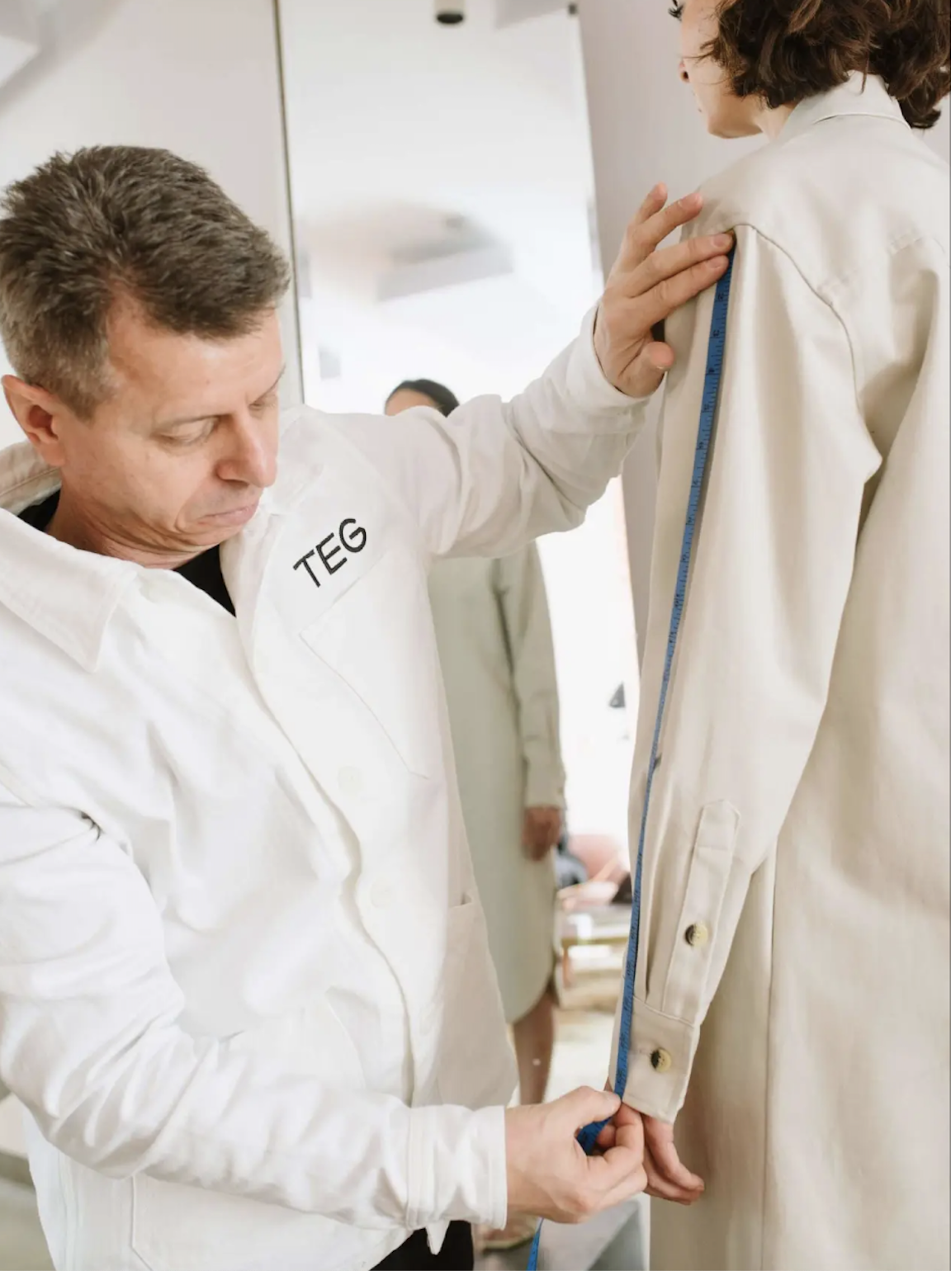

SOURCING
DEVELOPMENT
$1330 per style
subject to complexity
SOURCING INTAKE SESSION
DEVELOPMENT ONBOARDING SESSION
EXPERT INPUT AND PLANNING
TEG SPECIFICATION SHEETS COMPLETED
SWATCHES AND TRIMS GATHERED
TECHNICAL INTAKE WITH PATTERN MAKER
NEGOTIATE PRICING AND MINIMUMS
FIRST PATTERNS & FIRST SAMPLES
GUIDANCE IN POs AND ORDERING
ONE FITTING WITH PATTERN MAKER
TRACKING RECEIPT OF ORDERS
ONE ROUND OF FIT ADJUSTMENTS
1-2 ROUNDS OF REVISIONS
ONE DUPLICATE PER STYLE
FINAL PRODUCTION READY PATTERNS

Slide 11

PRIORITIES
SOURCE FABRIC AND TRIMS EFFECTIVELY
DEVELOP HIGH QUALITY PATTERNS & SAMPLES
PRODUCE A SMALL VOLUME PRODUCTION RUN FOR SALES

Slide 12
PRIORITIES
CREATE A MADE-IN-LA APPAREL BRAND
SOURCE FABRIC AND TRIMS EFFECTIVELY
DEVELOP HIGH QUALITY PATTERNS & SAMPLES
PRODUCE A SMALL VOLUME PRODUCTION RUN FOR SALES

Slide 13
PRIORITIES
SOURCE FABRIC & TRIMS EFFECTIVELY
MANAGE FABRIC TREATMENTS WITH PRECISION
DEVELOP HIGH QUALITY PATTERNS & SAMPLES
PRODUCE A SMALL VOLUME PRODUCTION RUN FOR SALES

Slide 14
PRIORITIES
SOURCE FABRIC AND TRIMS EFFECTIVELY
INSPECT + PRODUCE A SMALL VOLUME PRODUCTION RUN FOR SALES

Slide 15
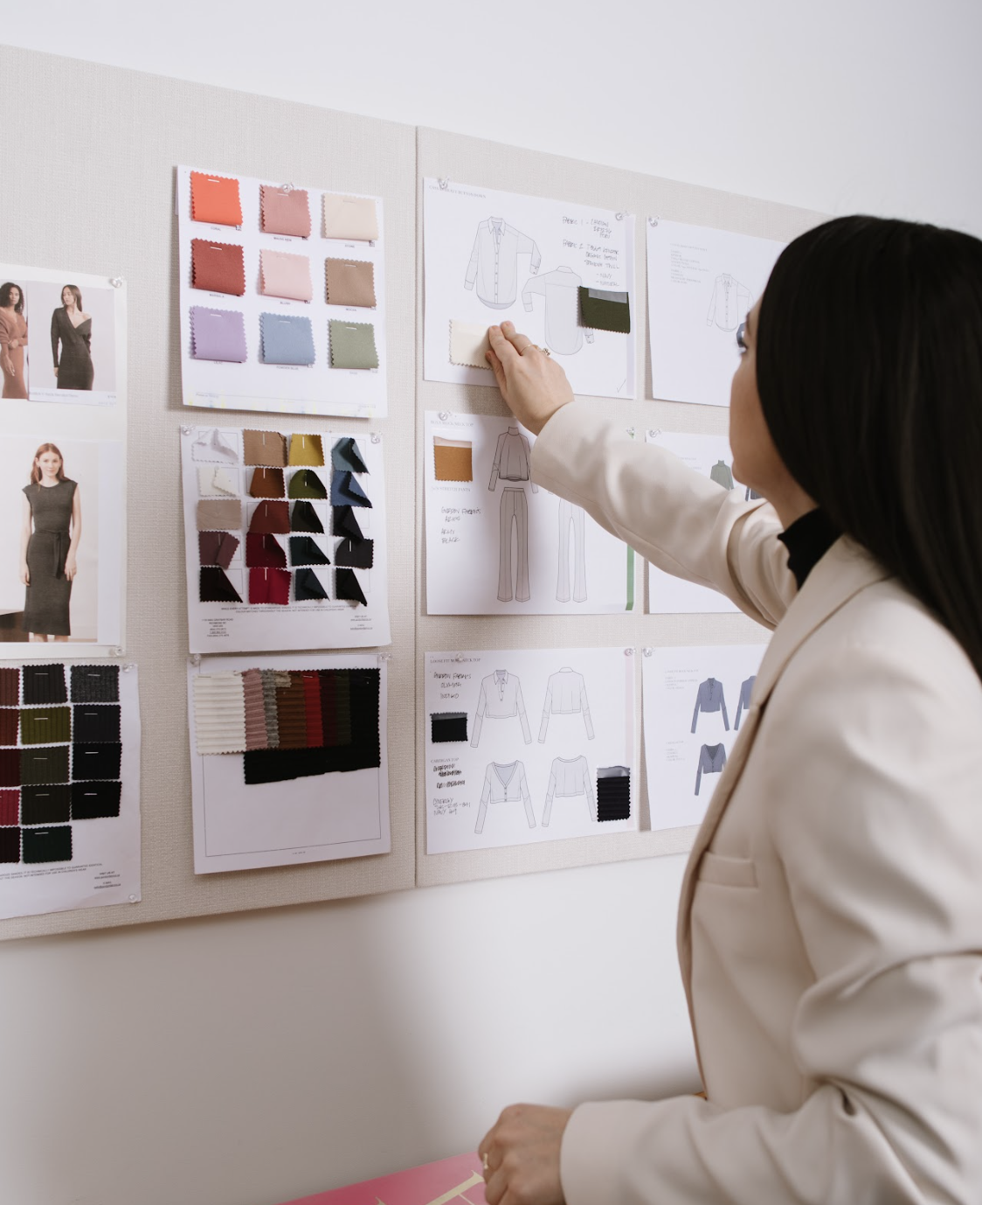
PRIORITIES
MANAGE FABRIC TREATMENTS WITH PRECISION
INSPECT PATTERNS + SEW SAMPLES
PRODUCE A SMALL VOLUME PRODUCTION RUN FOR SALES

Slide 16
SERVICES
01
02
03
04
Creative Planning
Up to 5 hours per style*
An all-encompassing, in-depth, creative strategy and planning service for your collection and overall brand.
Creative planning intake session
Three-phase action plan
Weekly on-hour check-ins
Collection development strategy
Overall design analysis
Merchandise and assortment planning
Competitive analysis
Target pricing guidance
Design
Up to 7 hours per style*
You will work directly with Danielle or Kyeshia to bring your inspiration and ideas into clear designs ready for development
Design intake session
Mood Board
Flat drawing of each style
Line sheet
Prints/colors rendered
Fabric color palette
1 – 2 rounds of revisions
*Optional fashion illustration
Sourcing
Up to 7 hours per style*
Danielle or Kyeshia will provide fabric swatches and trim samples for each style, and guides you through the purchase process.
• Sourcing intake session
• Expert input and planning
• Swatches and trims gathered
• Negotiate pricing and minimums
• Guidance in POs and ordering
• Tracking receipt of orders
• 1-2 rounds of revisions
Development
Up to 5 hours/pattern/sample*
Gery or Walter, along with our expert sample sewers, will create high-quality, perfectly fitting patterns and samples for your collection.
• Development Intake session
• TEG Specification Sheets completed
• Technical intake with pattern maker
• First patterns & first samples
• One fitting with pattern maker
• One round of fit adjustments
• One final sample per style
• Final production-ready patterns

Slide 17
05
06
07
08
Branding
An in-depth, full spectrum service to establish all aspects of your brand identity.
• Intake session to understand brand objectives and budget
• Brand Inspiration
• Sourcing of Banding Team*
• Brand Guidelines
• Brand Logo
• Color Pallette
• Typeface
• Photo Direction
• Tone of Voice
• Packaging
• Labels/Hangtags
Web Design
Work directly with a TEG marketing manager to create your brand website.
• Design intake session
• Website Inspiration
• Sourcing of Website Design Team*
• Establish use of Template or C Custom Website Design
• Website Design Mockups
• Placement of Client Provided Photos
• Placement of Client Provided Copy
• Product Display
• Final Approval
• Management & Communications
Web Development
Expert oversight in establishing a well functioning and performing website for your brand.
• Web Development intake session
• Sourcing of Web Development Team*
• Development Specifications
• Assistance with Platform Choice
• Product Display Data
• Optimization
• Final Approval
• Management and Communications
Online Marketing
Strategic sourcing of online marketing team and management of their services until launch.
•Online Marketing intake session
• Sourcing of Online Marketing Team*
•CMO
• Ads Manager
• SEO Manager
• Email Campaign Manager

Slide 18
09
10
12
Photoshoot Management
An in-depth, full spectrum service to establish all aspects of your brand identity.
• Intake session to understand objectives, budget, and brand alignment.
• Sourcing of Location*
• Sourcing of Photography*
• Sourcing of Models*
• Sourcing of Stylist*
• Sourcing of Equipment*
• Coordination of Shot List
• Coordination of On-Site Production
Social Media Planning
A service designed to source and manage a social media source or agency to launch and establish your brand’s social media presence and reach.
• Social Media Planning intake session
• Sourcing of Social Media Team*
• Overall Social Media Strategic Plan
• Social Media Automation
• Social Media Copywriter
• Social Media Engagement
• Optional Influencer Outreach**
Graphic Design
Expert design services customized to the individual needs of the client which can include:
• Graphic Design Intake Session
• Sourcing of Graphic Design Team*
• Email Templates
• Social Graphics
• Lookbook Layout
• Ad Graphics
* Sourcing includes sourcing of appropriate team and/or services and negotiation of pricing and timelines.
* Sourcing does not include fees for team or services.
* Client pays vendors directly for all services.
* A TEG Marketing Manager will oversee and track the project on behalf of the client through completion.
**Social Media Outreach is available for an additional fee and not available without Social Media Planning

